Slide 1
Data Mining
DM/ML model recap
模型概述
Qin Zhang
qinzhang@szu.edu.cn

Slide 2
Outline
DM/ML Model Overview
Decision Trees
Linear Method
Neural Networks

Slide 3




Types of ML Algorithms
Supervised
Semi-supervised
Train on labeled data to predict labels
Train on both labeled and unlabeled data, use models to infer labels for unlabeled data
E.g. self-training
Train on unlabeled data
E.g. clustering, density estimation
Use observations from the interaction with the environment to take actions to maximize reward
Unsupervised
Reinforcement
learning

Slide 4
Types of ML Algorithms
Supervised
Semi-supervised
We can design supervised training tasks for unlabeled data
Self-supervised learning: generate labels from data. E.g. word2vec, BERT
GAN: generating fake data with trivial label from unlabeled data,
Training tasks can be different from how the model is evaluated / used.
Unsupervised
Reinforcement
learning

Slide 5

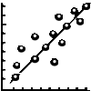


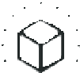
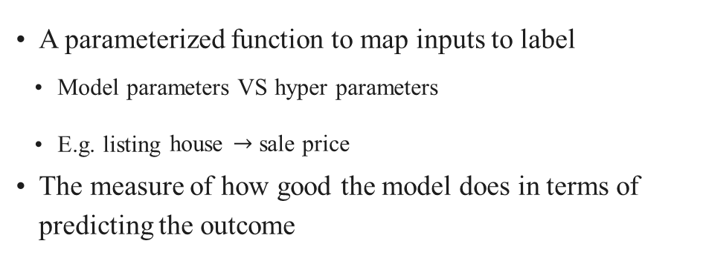
Components in Supervised Training
A parameterized function to map inputs to label
Model parameters VS hyper parameters
E.g. listing house $→$ sale price
The measure of how good the model does in terms of predicting the outcome
Model
Loss
E.g. classification / regression / contrastive / triplet / ranking
E.g. (predict_price − sale_price)²
The goal to optimize model params for
E.g. minimize the sum of losses over examples
The algorithm for solving the objective
Objective
Optimization

Slide 6
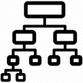
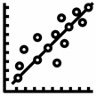
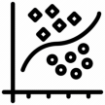
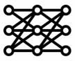
Types of Supervised Models
Decision trees
Use trees to make decisions
Decision is made from a linear combination of input features
Use kernel functions to compute feature similarities
Use neural networks to learn feature representations
Linear methods
Kernel machines
Neural Networks

Slide 7
Outline
ML Model Overview
Decision Trees
Linear Method
Neural Networks

Slide 8
Decision Trees
Classification
Regression
Explainable
Handle both numerical and categorical features without preprocessing
Have enough data?
Is in palo alto?
No
Yes
No
Yes
Improve Label?
Is living sqft > 2k
Collecting Data
Price = 1.2M
Yes
No
Yes
No
Data Labeling
Improve Data?
Price = 4.2M
Price = 2.8M

Slide 9
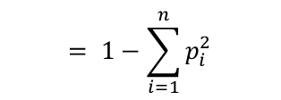
Building Decision Trees
Use a top-down approach, starting from the root node with the set of all features
At each parent node, pick a feature to split the examples
Feature selection criteria
Maximize variance reduction for continuous target
Maximize Information gain (1 - entropy) for categorical target
Maximize Gini impurity for categorical target
All examples are used for feature
selection at each node
E0
$$= 1−\sum_{i=1}^{n}{p_{i}^{2}}$$
Yes
No
E1
E2

Slide 10
Limitations of decision Trees
Over-complex trees can overfit the data
Limit the number of levels of splitting,
Prune branches
Sensitive to data
Changing a few examples can cause picking different features that lead to a different tree
Random forest
Not easy to be parallelized in computing

Slide 11
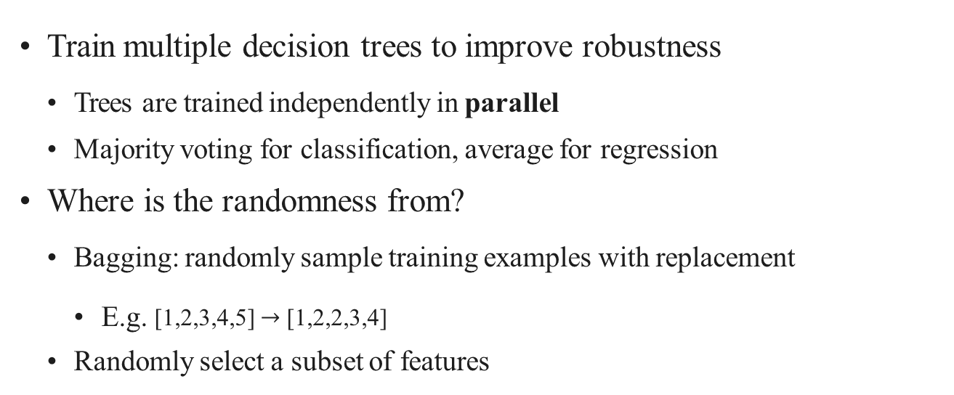
Random Forest
Train multiple decision trees to improve robustness
Trees are trained independently in parallel
Majority voting for classification, average for regression
Where is the randomness from?
Bagging: randomly sample training examples with replacement
E.g. [1,2,3,4,5] $→$ [1,2,2,3,4]
Randomly select a subset of features

Slide 12
Summary
Decision tree: an explainable model for classification/regression
Easy to train and tune, widely used in industry
Sensitive to data
Ensemble can help (more on bagging and boosting latter)

Slide 13
Outline
ML Model Overview
Decision Trees
Linear Method
Neural Networks

Slide 14
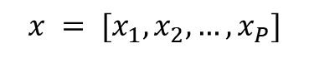
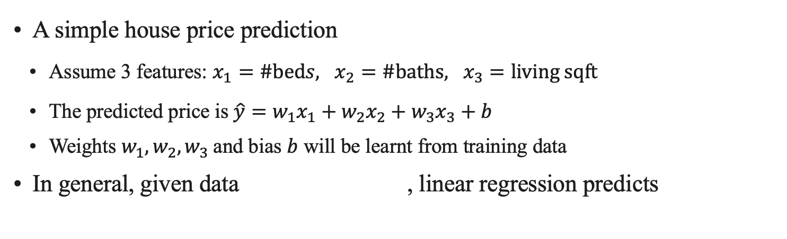
Linear Regression
A simple house price prediction
Assume 3 features: $x_{1}=\#beds, x_{2}=\#baths, x_{3}=living sqft$
The predicted price is $\hat{y}=w_{1}x_{1}+w_{2}x_{2}+w_{3}x_{3}+b$
Weights $w_{1}, w_{2}, w_{3}$and bias $b$ will be learnt from training data
In general, given data , linear regression predicts
$$x = [x_{1}, x_{2}, …,x_{P}]$$
$$\hat{y}= w_{1}x_{1}+w_{2}x_{2}+…+w_{p}x_{p}+b = ⟨w, x⟩ + b$$
Code: Trainable weights $w=[w_{1}, w_{2}, …,w_{p}]$and bias $b$
# weight w has shape (p, 1)
# bias b is a scalar
# data x has shape (p, 1)
y_hat = (x*w).sum() + b

Slide 15
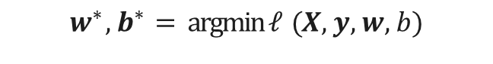
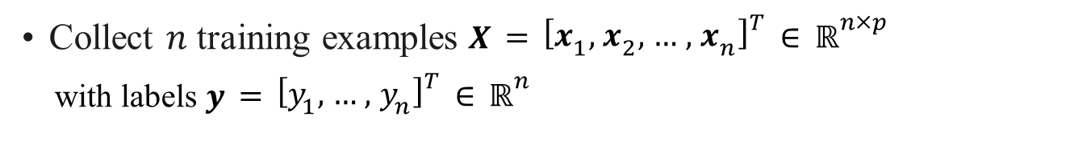
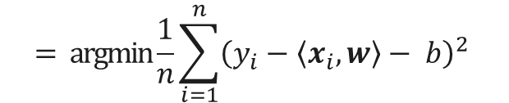
Objective Function
Collect $n$ training examples $X={\left[x_{1},x_{2},…,x_{n}\right]}^{T}∈ℝ^{n×p}$
with labels $y={\left[y_{1}, …, y_{n}\right]}^{T}∈ℝ^{n}$
E.g. house listings and sold prices
Objective: minimize the mean square error (MSE)
$$w^{∗}, b^{∗}=argmin ℓ(X, y, w, b)$$
w,b
$$=argmin\frac{1}{n}\sum_{i=1}^{n}{{\left(y_{i}−\left\langle x_{i}, w\right\rangle − b\right)}^{2}}$$
w,b

Slide 16
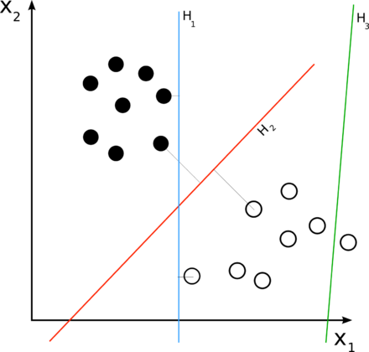
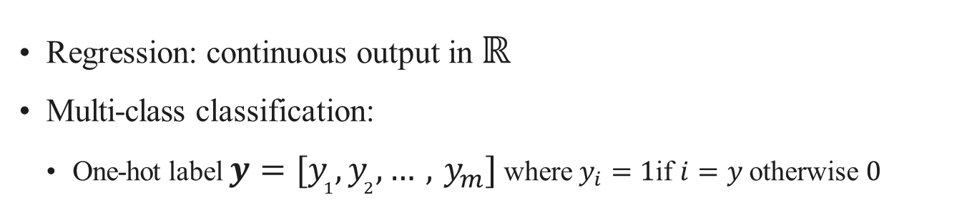
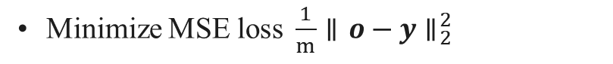
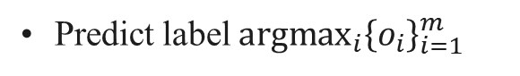
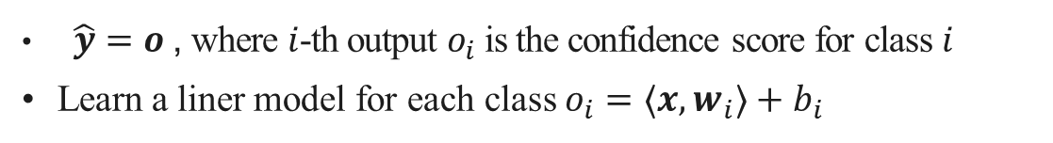
Use linear regression for classification problem
Regression: continuous output in ℝ
Multi-class classification:
One-hot label $y=[y_{1}, y_{2}, …, y_{m}]$ where $y_{i}=1$if $i=y$otherwise $0$
$\hat{y}=o$, where $i$-th output $o_{i}$ is the confidence score for class $i$
Learn a liner model for each class $o_{i}=⟨x, w_{i}⟩+b_{i}$
Minimize MSE loss $\frac{1}{m}∥o−y∥_{2}^{2}$
Predict label ${argmax}_{i}{\left\{o_{i}\right\}}_{i=1}^{m}$
Waste model capacity on pushing $o_{i}$ near $0$ for off labels

Slide 17
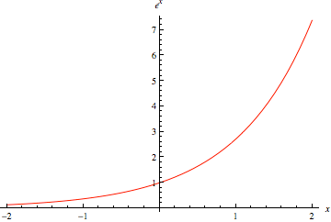
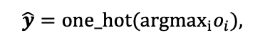
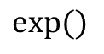
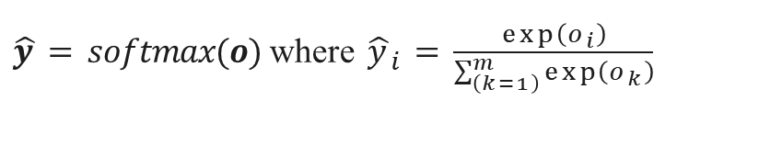
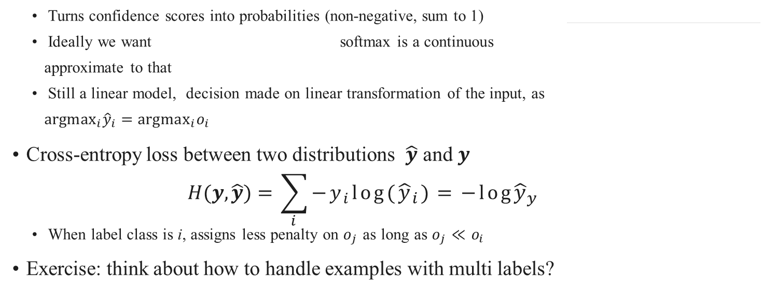
Softmax Regression
One-hot label $y=[y_{1}, y_{2}, …, y_{m}]$ where $y_{i}=1$if $i=y$otherwise $0$
$\hat{y}=softmax(o)$where ${\hat{y}}_{i}=\frac{\exp\left(o_{i}\right)}{\sum_{\left(k=1\right)}^{m}{\exp\left(o_{k}\right)}}$
•
$$exp⁡()$$
Turns confidence scores into probabilities (non-negative, sum to 1)
Ideally we want softmax is a continuous
approximate to that
Still a linear model, decision made on linear transformation of the input, as
${argmax}_{i}{\hat{y}}_{i}={argmax}_{i}o_{i}$
Cross-entropy loss between two distributions $\hat{y}$ and $y$
$$H(y,\hat{y})=\sum_{i}{−y_{i}log({\hat{y}}_{i})=−log{\hat{y}}_{y}}$$
When label class is i, assigns less penalty on $o_{j}$as long as $o_{j}≪o_{i}$
Exercise: think about how to handle examples with multi labels?
$$\hat{y}=one_hot(argmax_{i}o_{i}),$$

Slide 18
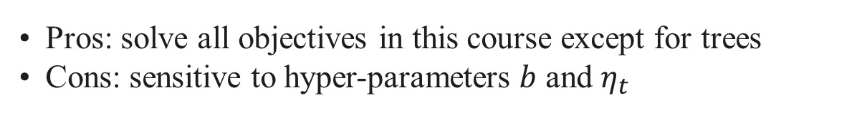
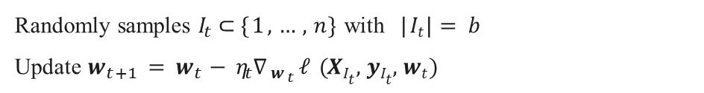
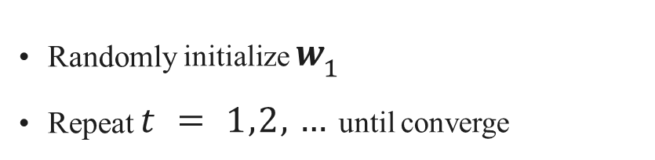
Mini-batch Stochastic gradient descent (SGD)
Train by mini-batch SGD (by various other ways as well)
$w$ model param, $b$ batch size, $η_{t}$ learning rate at time $t$
•
Randomly initialize $w_{1}$
Repeat $t=1,2,…$until converge
•
•
Randomly samples $I_{t}⊂\{1,…, n\}$with $| It |=b$
Update $w_{t+1} =w_{t}−η_{t} ∇_{w_{t}}ℓ(XIt, yIt, wt)$
Pros: solve all objectives in this course except for trees
Cons: sensitive to hyper-parameters $b$ and $η_{t}$

Slide 19
Code
# `features` shape is (n, p), `labels` shape is (n, 1)
Train a linear regression model with min-batch SGD
Hyperparameters
batch_size
learning_rate
num_epochs
def data_iter(batch_size, features, labels): num_examples = len(features)
indices = list(range(num_examples))
random.shuffle(indices) # read examples at random
for i in range(0, num_examples, batch_size):
batch_indices = torch.tensor(
indices[i:min(i + batch_size, num_examples)])
yield features[batch_indices], labels[batch_indices]
w = torch.normal(0, 0.01, size=(p, 1), requires_grad=True)
b = torch.zeros(1, requires_grad=True)
for epoch in range(num_epochs):
for X, y in data_iter(batch_size, features, labels):
y_hat = X @ w + b
loss = ((y_hat - y)**2 / 2).mean()
Full code at: http://d2l.ai/chapter_linear- networks/linear-regression-scratch.html
loss.backward()
for param in [w, b]:
param -= learning_rate * param.grad
param.grad.zero_()

Slide 20
Summary
Linear methods linearly combine inputs to obtain predictions
Linear regression uses MSE as the loss function
Softmax regression is used for multiclass classification
Turn predictions into probabilities and use cross-entropy as loss
Cross entropy loss between two probability distribution
Mini-batch SGD can learn both models (and later neural networks as well)

Slide 21
Outline
ML Model Overview
Decision Trees
Linear Method
Neural Networks

Slide 22
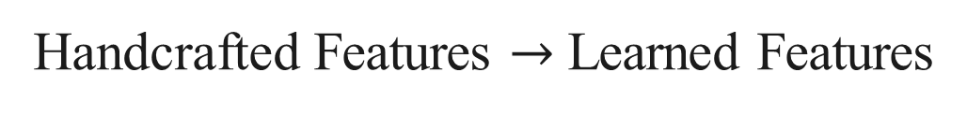
Handcrafted Features $→$ Learned Features
Outputs Outputs
NN usually requires more data and more computation
NN architectures to model data
Linear/ softmax regression
Linear/ softmax regression
structures
Multilayer perceptions
Convolutional neural networks
Recurrent neural networks
Attention mechanism
Design NN to incorporate(混合，包含) prior knowledge about the data
Handcrafted feature extraction
Neural Networks
Raw data
Raw data

Slide 23
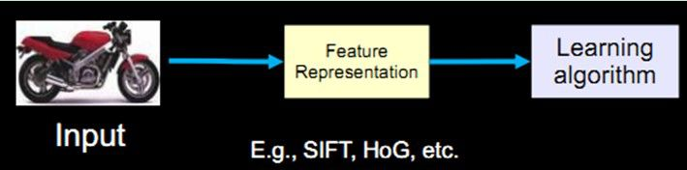
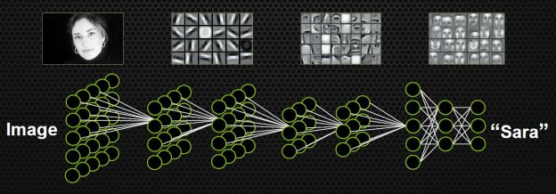
深度学习-手工设计特征到自动化构造特征

Slide 24
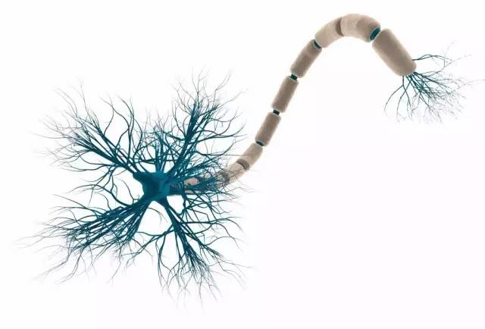
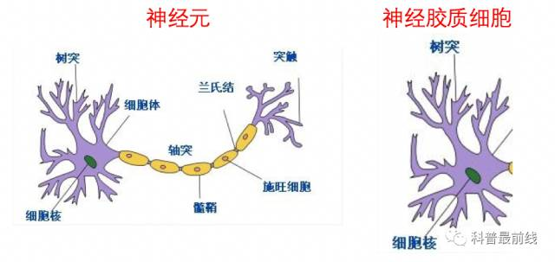
神经元
神经元
神经元具体结构
树突：有多个，主要用来接受传入信息
细胞核：对信号进行计算
轴突：只有一条，用于信号传递
突触：轴突末梢跟其他神经元的树突产生连接，从而传递信号。这个连接的位置在生物学上叫做“突触”。
一个神经元接入了多个输入，经过计算最终变成一个输出，传递给了后面的神经元
Notes:
树突可以从上一个神经元，或者是其他刺激输入源，比如说触觉、味觉接收器，接受刺激，并将冲动传向胞体
如果胞体接受得到的冲动足够强，电位超过一定阈值，就会“兴奋”
轴突从胞体接受冲动，然后将它传播出去，最终到达目的地，或是下一个神经元

Slide 25
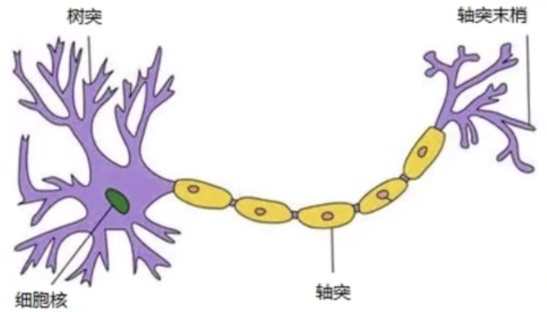
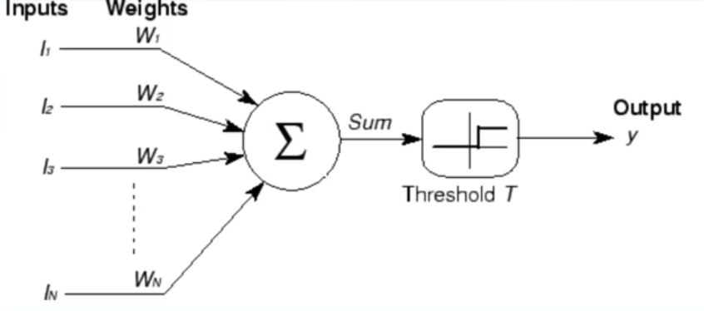
人工神经元
人工神经元：人类神经元中抽象出来的数学模型。
1904年研究出人类神经元
1943年心理学家W.S.McCulloch和数学逻辑学家W.Pitts研究出人工神经元，称为M-P模型

Slide 26

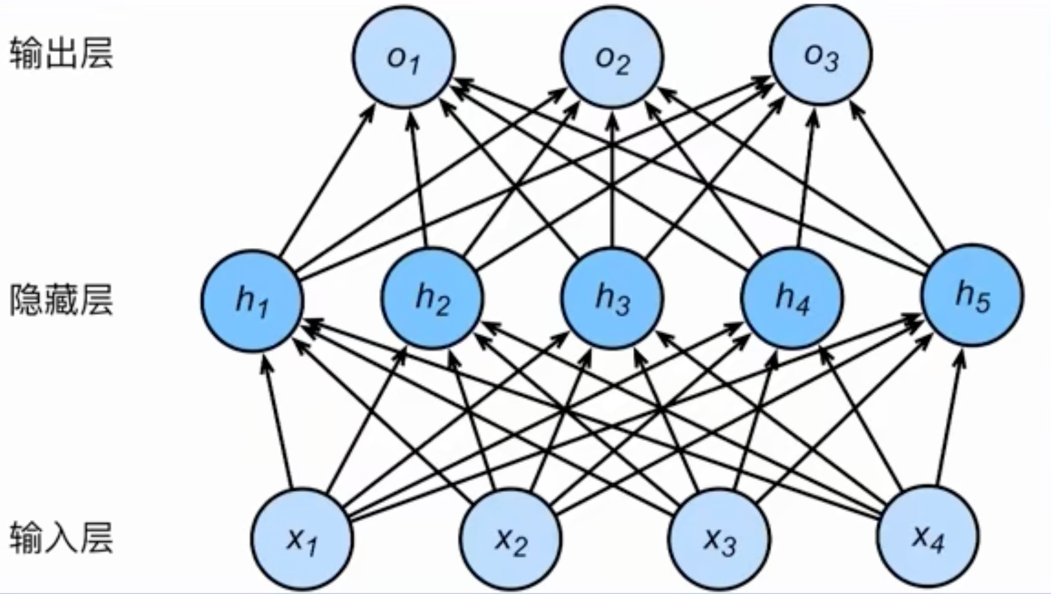
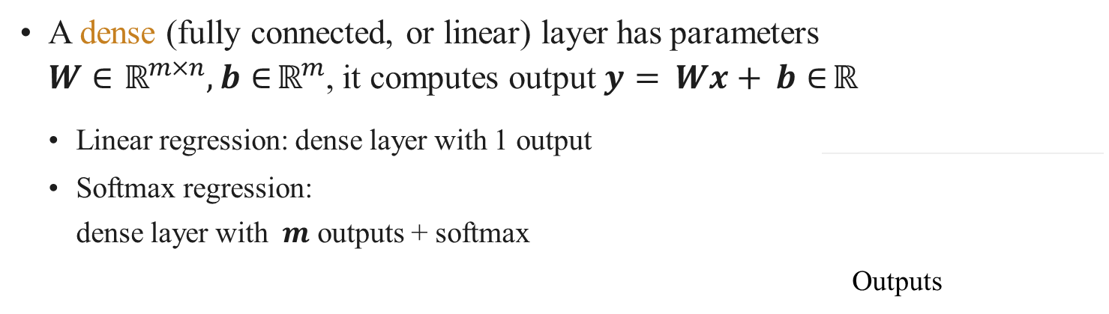
Linear Methods $→$ Multilayer Perceptron (MLP)
A dense (fully connected, or linear) layer has parameters
$W∈ ℝ^{m×n}, b∈ℝ^{m}$, it computes output $y=Wx+b∈ℝ$
Linear regression: dense layer with 1 output
Softmax regression:
dense layer with $m$ outputs + softmax
Outputs
Linear methods:
Dense
Inputs

Slide 27
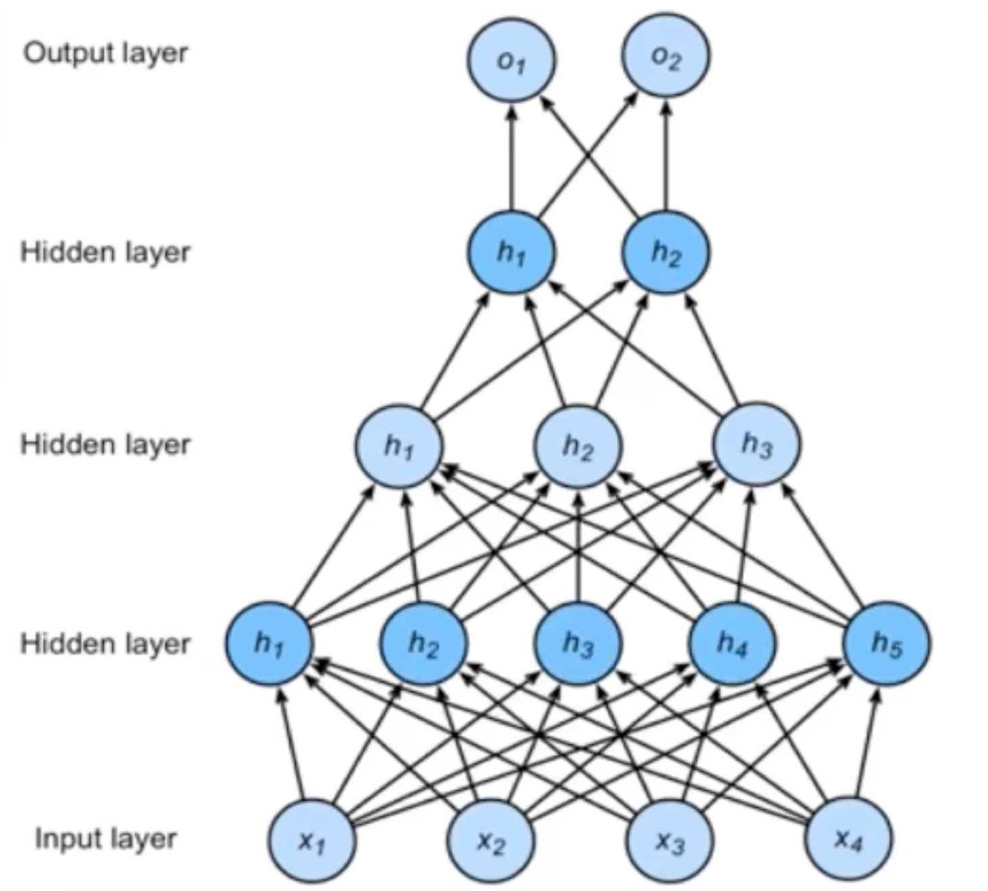
多层感知机
多层感知机（MLP,Multi layer perceptron):单层神经网络基础上引入一个或者多个隐藏层，使神经网络有多个网络层。

Slide 28
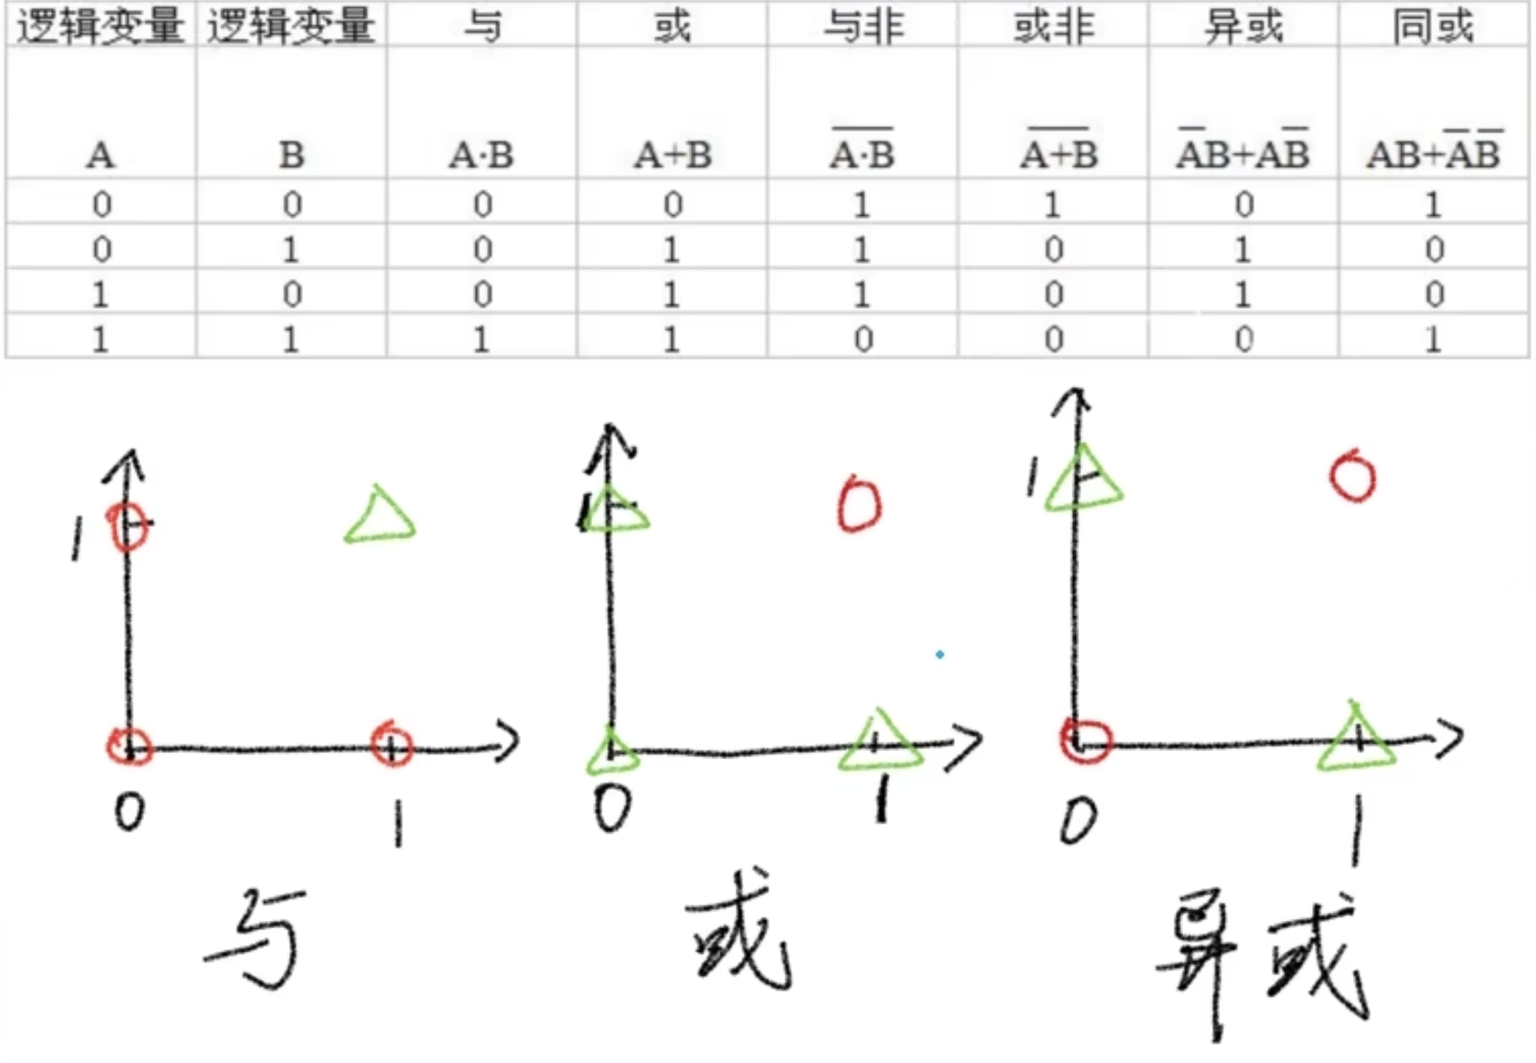
感知机
感知机致命缺点：Minsky在1969年证明Perceptron无法解决异或问题。

Slide 29
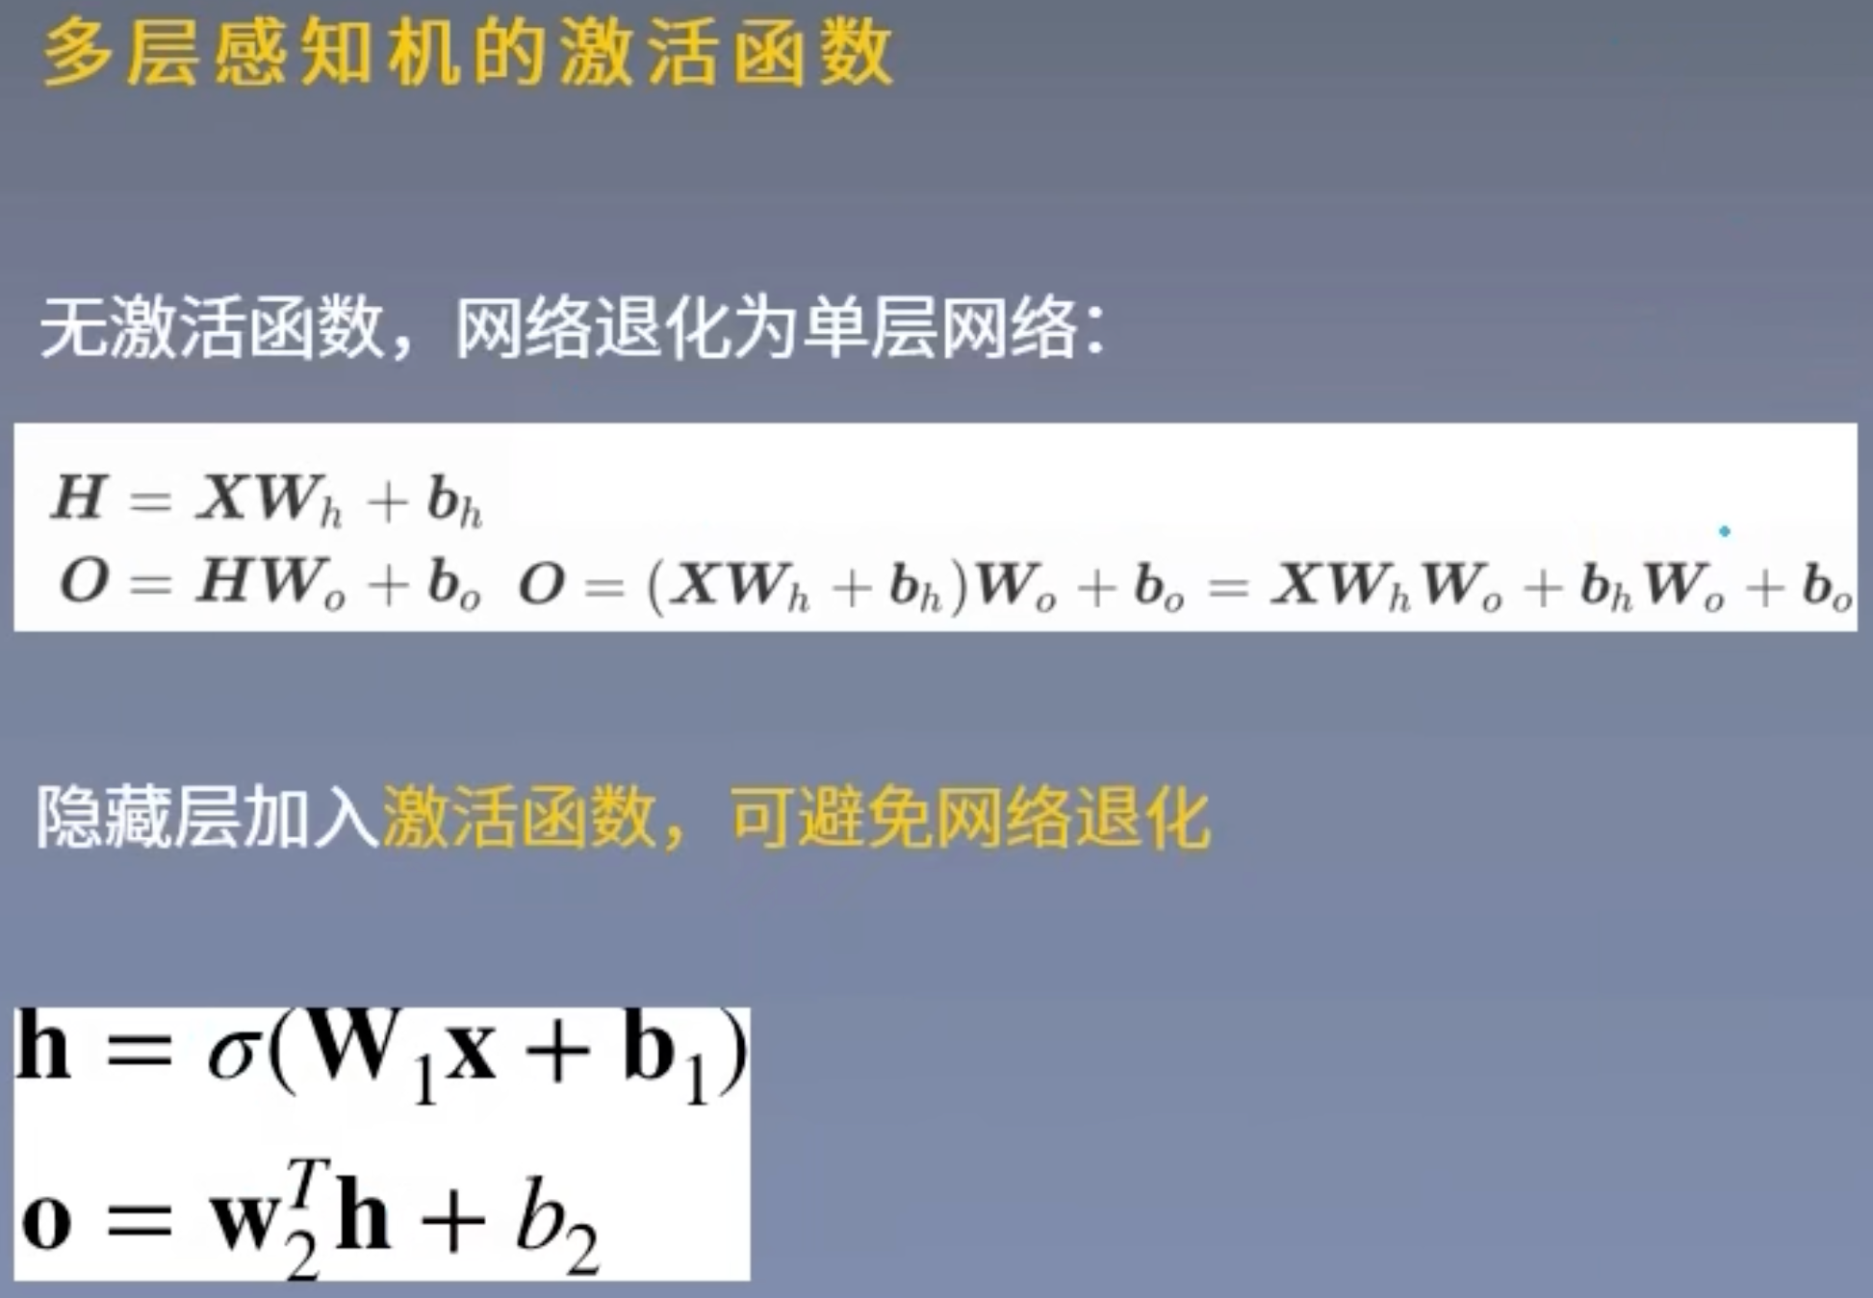
多层感知机

Slide 30
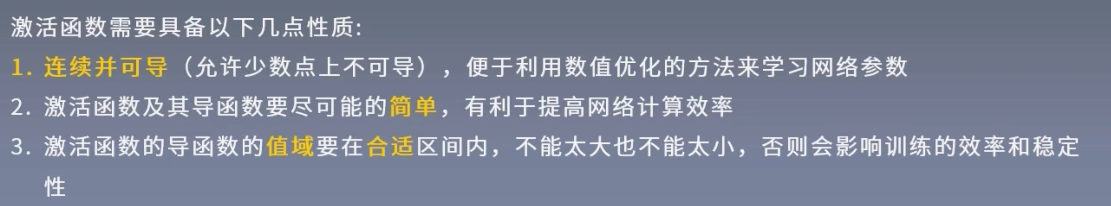
激活函数
激活函数的功能：
1）让多层感知机成为真正的多层，否则等价于一层
2）引入非线性，使网络可以逼近任意非线性函数（万能逼近定理，universal approximator）

Slide 31
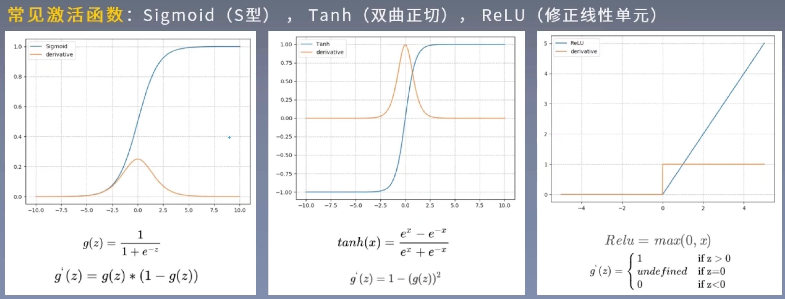
激活函数

Slide 32
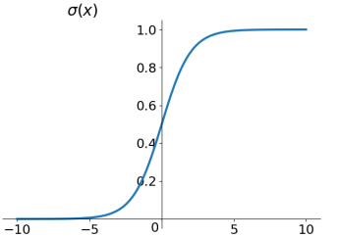
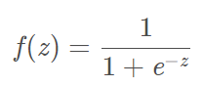
激活函数 - Sigmoid激活函数
如果不用激励函数，在这种情况下你每一层节点的输入都是上层输出的线性函数，很容易验证，无论你神经网络有多少层，输出都是输入的线性组合，与没有隐藏层效果相当，这种情况就是最原始的感知机（Perceptron）了，那么网络的逼近能力就相当有限，不能处理非线性数据。
激活函数的目的是引入非线性
Sigmoid函数
缺点1：Sigmoid 的 output 不是0均值（即zero-centered），会导致后一层的神经元将得到上一层输出的非0均值的信号作为输入。如x>0, f=w^{T}x+b,那么对w求局部梯度则都为正，这样在反向传播的过程中w都往正方向更新，导致有一种捆绑的效果，使得收敛缓慢。
缺点2：其解析式中含有幂运算，计算机求解时相对来讲比较耗时。对于规模比较大的深度网络，这会较大地增加训练时间。
缺点3：在深度神经网络中梯度反向传递时导致梯度爆炸和梯度消失，其中梯度爆炸发生的概率非常小，而梯度消失发生的概率比较大。

Slide 33
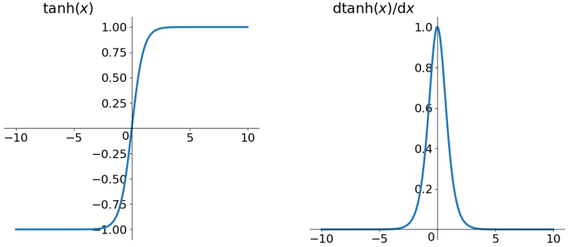
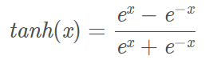
激活函数 - Tanh激活函数
Tanh（Hyperbolic Tangent）函数
它解决了Sigmoid函数的不是zero-centered输出问题，然而，梯度消失的问题和幂运算的问题仍然存在。

Slide 34
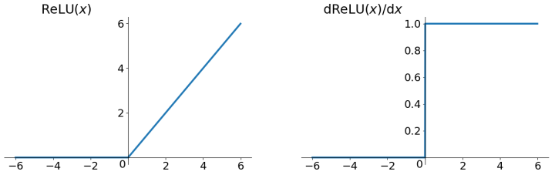
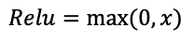
激活函数 - Relu激活函数
$$Relu=max⁡(0,x)$$
ReLU优点：
解决了gradient vanishing问题 (在正区间)
计算速度非常快，只需要判断输入是否大于0
收敛速度远快于sigmoid和tanh
ReLU也有几个需要特别注意的问题：
1）ReLU的输出不是zero-centered
2）Dead ReLU Problem，指的是某些神经元可能永远不会被激活，导致相应的参数永远不能被更新。有两个主要原因可能导致这种情况产生: (1) 非常不幸的参数初始化，这种情况比较少见 (2) learning rate太高导致在训练过程中参数更新太大，不幸使网络进入这种状态。解决方法是可以采用Xavier初始化方法，以及避免将learning rate设置太大或使用adagrad等自动调节learning rate的算法。
ReLU是最常用的activation function，在搭建人工神经网络的时候推荐优先尝试！

Slide 35
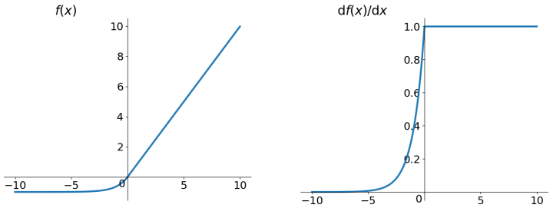
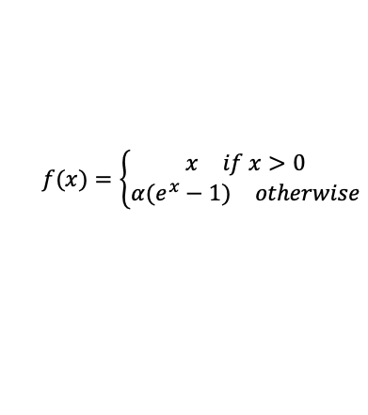
激活函数 - ELU (Exponential Linear Units)激活函数
$$f(x)=\left\{\begin{matrix}\begin{matrix}x & if x>0\end{matrix} \\ \begin{matrix}α(e^{x}−1) & otherwise\end{matrix}\end{matrix}\right.$$
ELU优点：
不会有Dead ReLU问题
输出的均值接近0，zero-centered
ELU缺点：
1）计算量稍大
理论上ELU虽然好于ReLU，但在实际使用中目前并没有好的证据ELU总是优于ReLU。

Slide 36
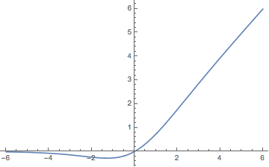

激活函数 - swish激活函数
谷歌团队的测试结果表明该函数在很多模型都优于ReLu。

Slide 37


Multilayer Perceptron (MLP)
Outputs
Activation is a elemental-wise non-linear function
Activation
sigmoid$\left(x\right)=\frac{1}{1+exp⁡(−x)}$
, $ReLU(x)=max⁡(x,0)$
It leads to non-linear models
Stack multiple hidden layers
(dense + activation) to get deeper models
Hyper-parameters:
# hidden layers, # outputs of each hidden layer
Universal approximation theorem
（一个包含足够多隐层神经元的多层前馈网络，能以任意精度逼近任意预定的连续函数）
Dense
MLP with
1 hidden layer
Activation
Dense
Outputs
Activation
Activation
Dense
Dense
Inputs
Inputs

Slide 38
Code
MLP with 1 hidden layer
Hyperparameter: num_hiddens
def relu(X):
return torch.max(X, 0)
W1 = nn.Parameter(torch.randn(num_inputs, num_hiddens) * 0.01) b1 = nn.Parameter(torch.zeros(num_hiddens))
W2 = nn.Parameter(torch.randn(num_hiddens, num_outputs) * 0.01) b2 = nn.Parameter(torch.zeros(num_outputs))
H = relu(X @ W1 + b1) Y = H @ W2 + b2
Full code: http://d2l.ai/chapter_multilayer-
perceptrons/mlp-scratch.html

Slide 39



Dense layer $→$ Convolution layer
Learn ImageNet (300$×$300 images with 1K classes) by a MLP with a single hidden layer with 10K outputs
It leads to 1 billion learnable parameters, that’s too big!
Fully connected: an output is a weighted sum over all inputs
Recognize objects in images
Translation invariance: similar output no matter where the object is
Locality: pixels are more related to near neighbors
Build the prior knowledge into the model structure
Achieve same model capacity with less # params

Slide 40











Convolution layer
Locality: an output is computed from $k× k$input windows
Translation invariant: outputs use the same $k× k$weights (kernel)
# model params of a conv layer does not
Learnable parameters
depend on input/output sizes
$n×m→k× k$
A kernel may learn to identify a pattern
Outputs
Dense Layer
Convolution

Slide 41
Code
Convolution with matrix input and matrix output (single channel)
# both input `X` and weight `K` are matrices h, w = K.shape
Y = torch.zeros((X.shape[0] - h + 1, X.shape[1] - w + 1))
# stride = 1
for i in range(Y.shape[0]):
for j in range(Y.shape[1]):
Y[i, j] = (X[I : i+h, j : j+w] * K).sum()
K
X
K
X
Y[0, 0]
Exercise: implement multi-channel input / output convolution
Y[0, 1]
Full code: http://d2l.ai/chapter_convolutional- neural-networks/conv-layer.html

Slide 42

Pooling Layer
Convolution is sensitive to local location
A translation/rotation of a pattern in the input results similar changes of a pattern in the output
A pooling layer computes mean/max in windows of size $k× k$
# h, w: pooling window height and width # mode: max or avg
Y = torch.zeros((X.shape[0] - h + 1, X.shape[1] - w + 1))
P
X
P
X
for i in range(Y.shape[0]):
for j in range(Y.shape[1]):
if mode == 'max':
Y[i, j] = X[i : i+h, j : j+w].max() elif mode == 'avg':
Y[i, j] = X[i : i+h, j : j+w].mean()
Y[0, 0] Y[0, 1]
Full code: http://d2l.ai/ chapter_convolutional-neural-networks/ pooling.html

Slide 43

Convolutional Neural Networks (CNN)
Outputs
Stacking convolution layers to extract features
Activation is applied after each convolution layer
Using pooling to reduce location sensitivity
Modern CNNs are deep neural network with various hyper-parameters and layer connections (AlexNet, VGG, Inceptions, ResNet, MobileNet)
lenet = nn.Sequential(
Dense
nn.Conv2d(...),
nn.Sigmoid(),
Pooling
nn.AvgPool2d(...),
nn.Conv2d(),
nn.Sigmoid(),
Conv
nn.AvgPool2d(...),
nn.Flatten(),
nn.Linear(...),
Pooling
nn.Sigmoid(),
nn.Linear(...),
nn.Sigmoid(), nn.Linear(...))
Conv

Slide 44


Dense layer $→$ Recurrent networks
Language model: predict the next word
Hello $→$ world hello world $→$ !
Use MLP naively doesn’t handle sequence info well:
RNN
world
!
Split
world
!
Dense
Dense
Dense
Dense
world
Hidden status
Concat
hello
hello
world

Slide 45






RNN and Gated RNN
The only diff to MLP
Simple RNN:
$$h_{t} = φ(W_{hh}h_{t−1}+W_{hx}x_{t}+b_{h})$$
$$yt$$
time $t$:
$$h_{t−1}$$
$$ht$$
RNN RNN
RNN
$$x_{t}$$
Gated RNN (LSTM, GRU): finer control of information flow
Forget input: suppress(压制) $x_{t}$ when computing $h_{t}$
Forget past: suppress $h_{t−1}$ when computing $h_{t}$

Slide 46
Code
Implement Simple RNN
W_xh = nn.Parameter(torch.randn(num_inputs, num_hiddens) * 0.01)
W_hh = nn.Parameter(torch.rand(num_hiddens, num_hiddens) * 0.01)
b_h = nn.Parameter(torch.zeros(num_hiddens))
H = torch.zeros(num_hiddens)
outputs = []
for X in inputs: # `inputs` shape : (num_steps, batch_size, num_inputs)
H = torch.tanh(X @ W_xh + H @ W_hh + b_h)
outputs.append(H)
Full code at http://d2l.ai/chapter_recurrent-neural-networks/ rnn-scratch.html

Slide 47






Bi-RNN and Deep RNN
Bidirectional RNN
Deep RNN
$$y_{t}$$
Outputs
Simple RNN, GRU,
or LSTM
RNN
Reverse direction
Forward direction
RNN
Can be bidirectional
RNN
RNN
RNN
$$x_{t}$$
Inputs
$$t − 1$$
$t$
$$t + 1$$
$t$

Slide 48



Model Selections
Tabular
Text / speech
Images / audio / video
Transformers (Cover later)
Trees
Linear/MLP
RNNs
CNNs

Slide 49
Summary
MLP: stack dense layers with non-linear activations
CNN: stack convolution activation and pooling layers to efficient extract spatial information
RNN: stack recurrent layers to pass temporal information through hidden state

